Slide 1
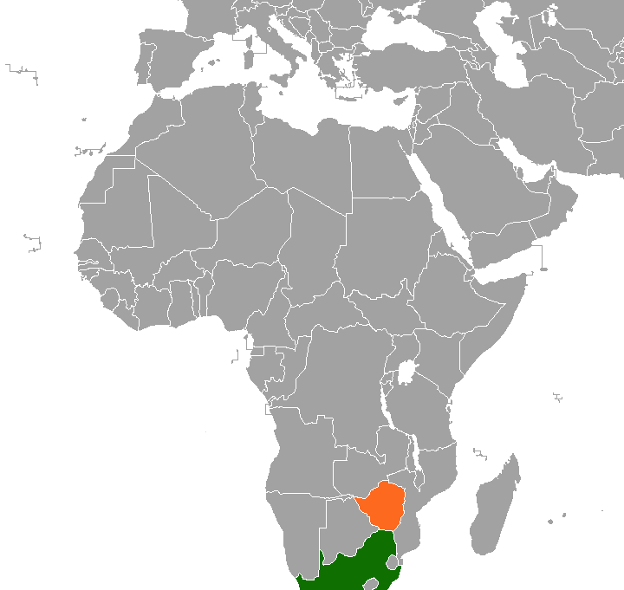
Zimbabwe Evangelism Trip
September 1-15, 2022

Slide 2
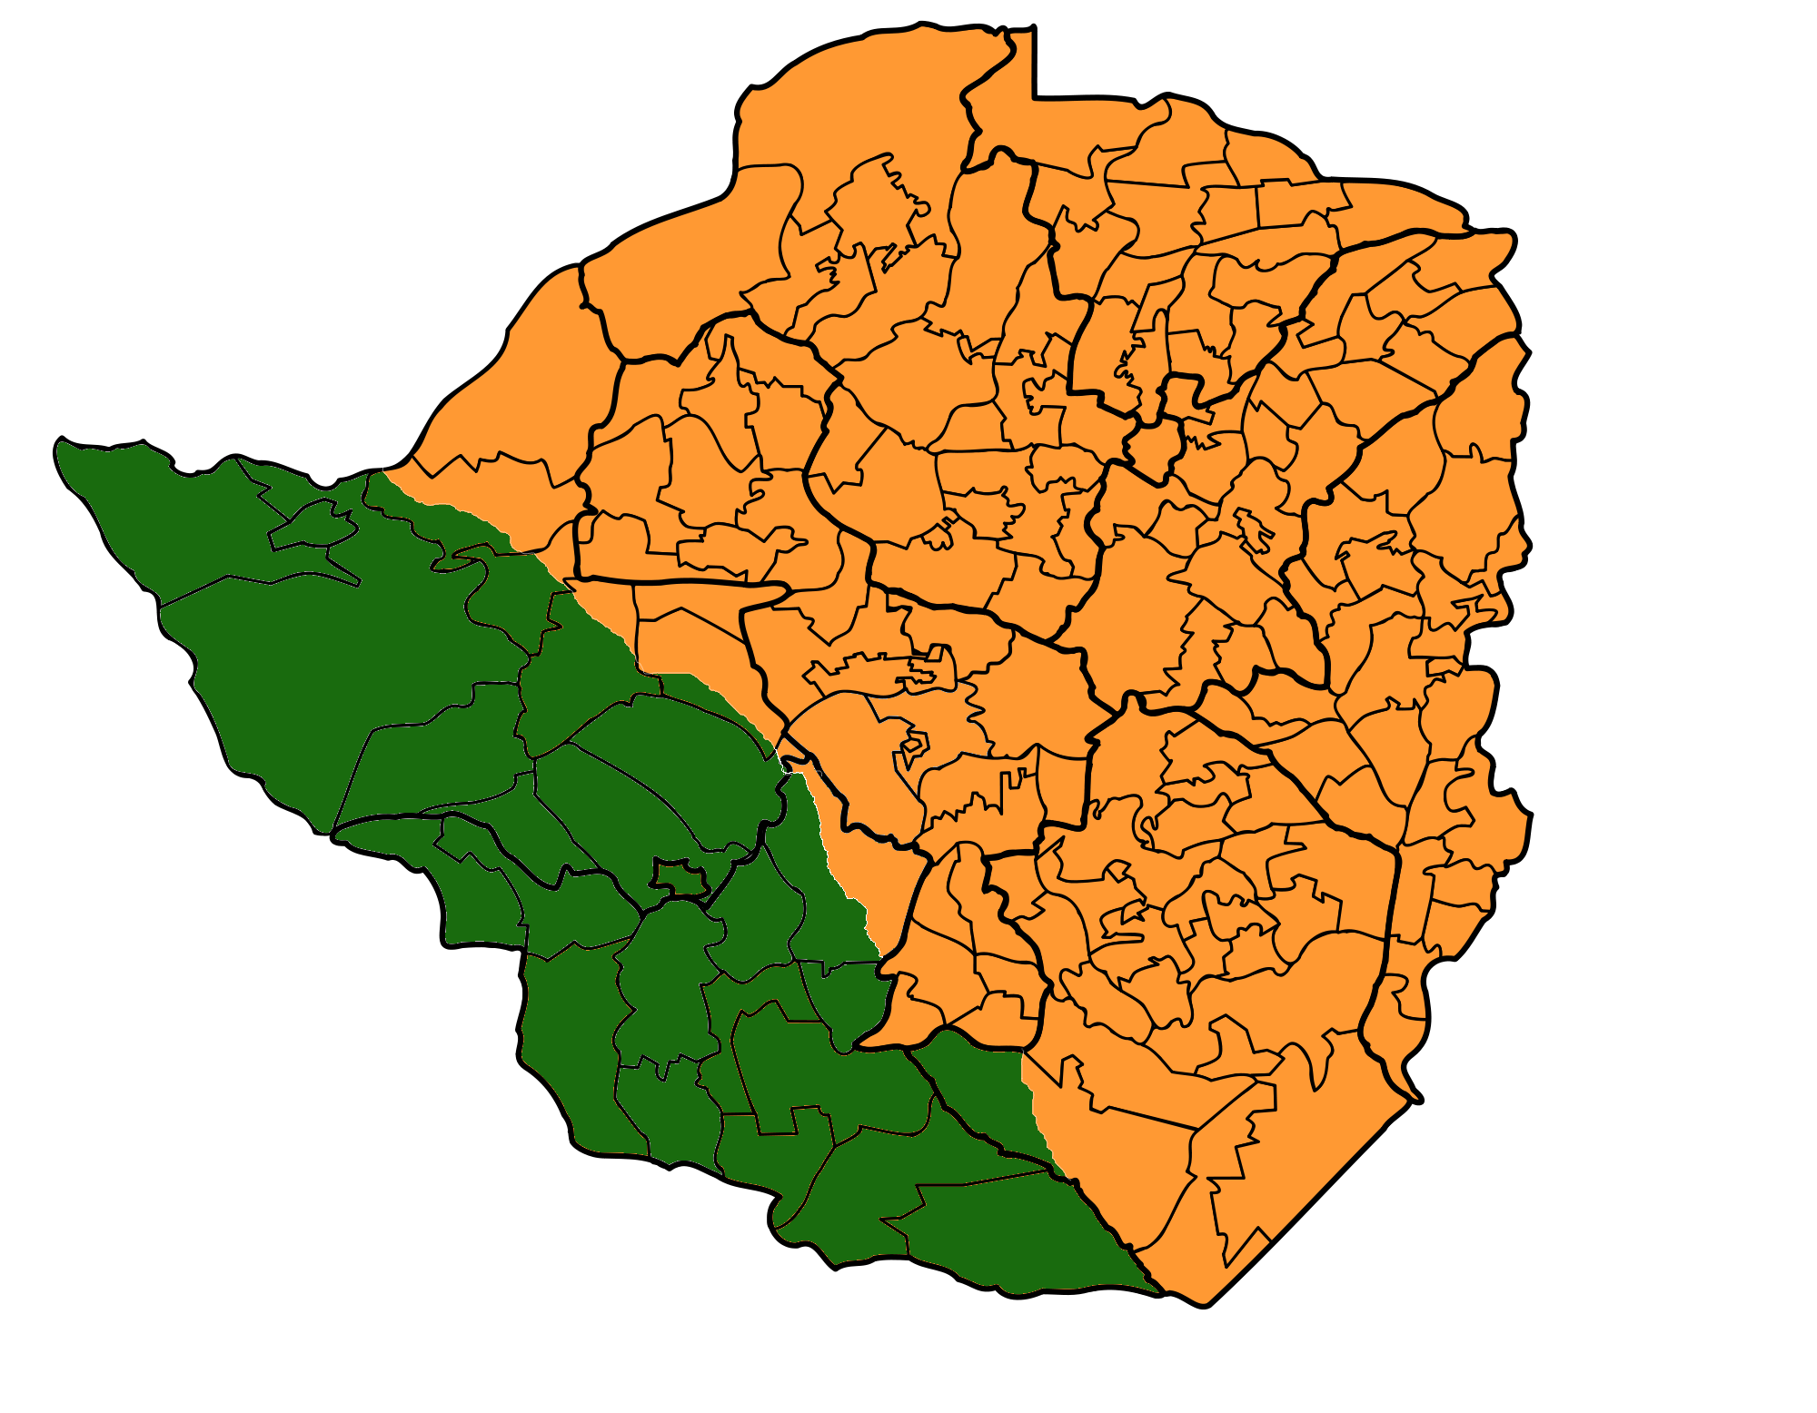
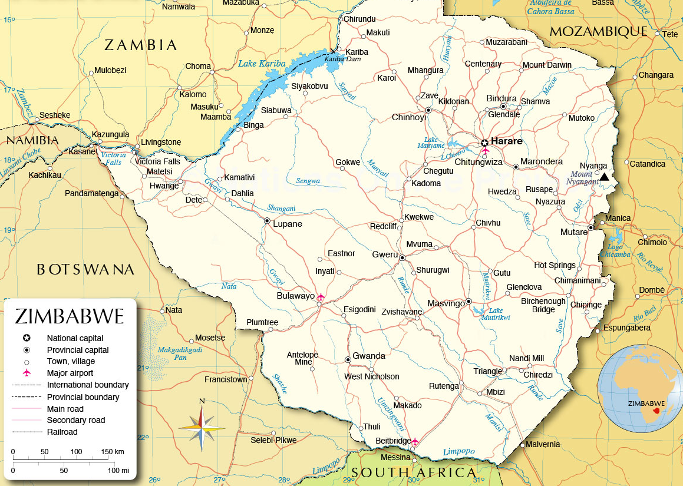
Tonga
Shona
Ndebele
Venda

Slide 3
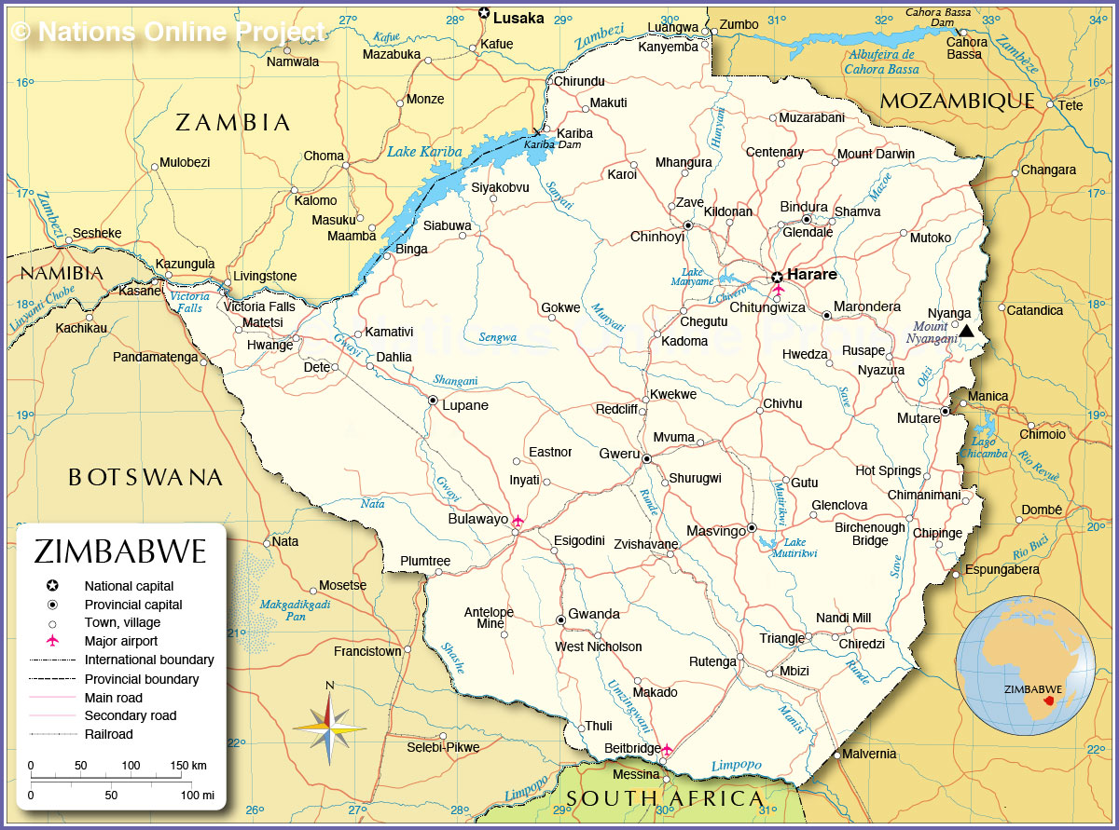

Zimbabwe Evangelism Trip
July 2022
Notes:
The circle is roughly the size of Alabama. This is the area we traveled in and visited brethren.

Slide 4
Zimbabwe Evangelism Trip
September 1-15, 2022

Slide 5
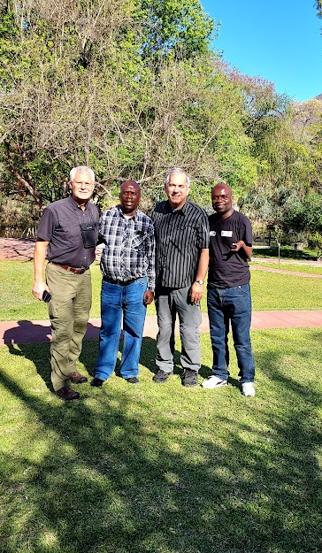

Joe Greer
Bigboy Dube
Steve Klein
Pick Nkomwa
Notes:
Upon arrival in Gwanda, Saturday, September 3rd.

Slide 6
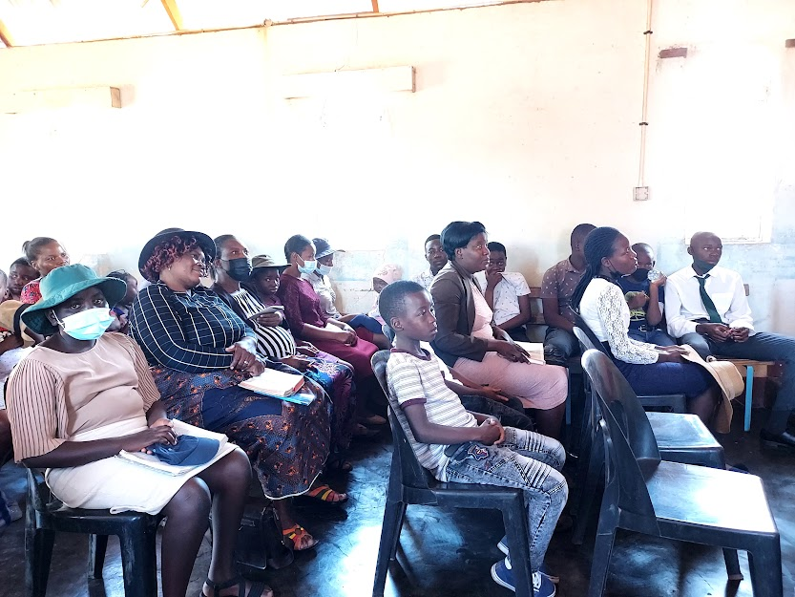
Sunday, September 4
Saints at Gwanda

Slide 7
Binga
Livingstone
Harare (2x)
Hauna
Zimbabwe Preachers’ Studies
2011-2022
Victoria Falls
Mutare (Vumba)
Bulawayo (3x)
Masvingo
Gwanda (2x)

Slide 8
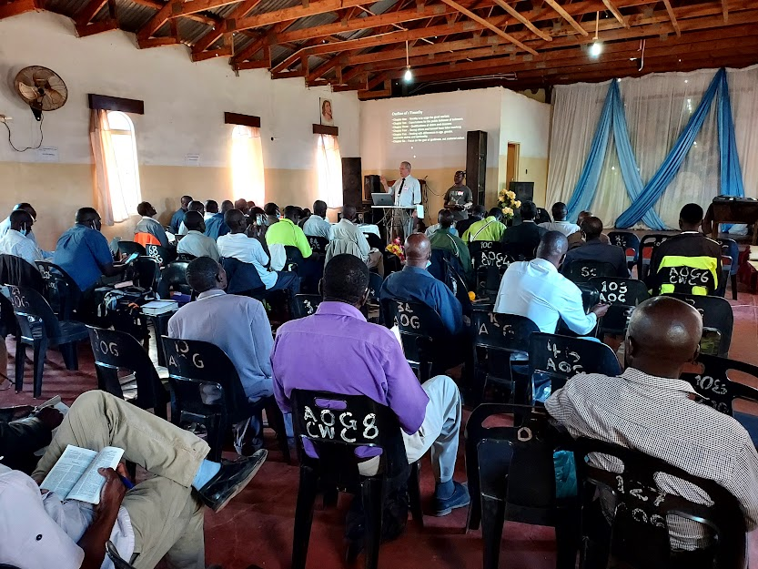
Classes for Preachers in Gwanda September 5-6, 2022
We were expecting 20 to 25 brethren, but we had over 40.
Notes:
Lessons needed translating.

Slide 9
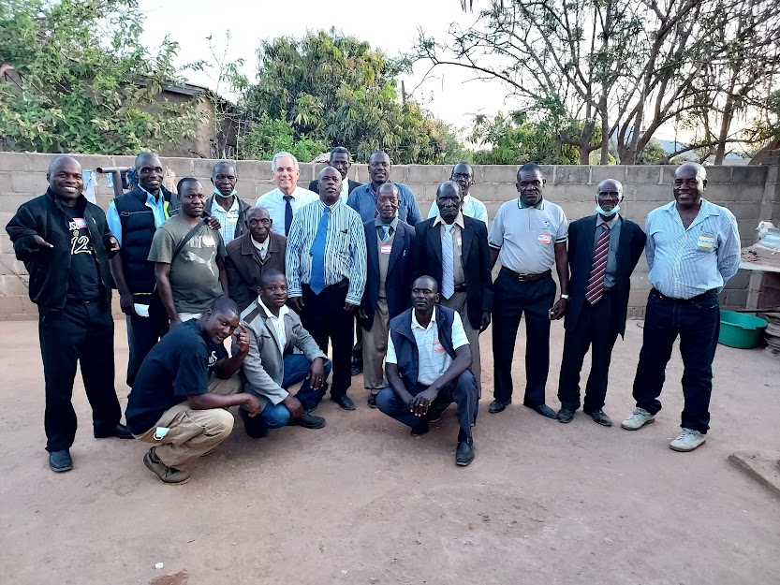
Preachers from churches that have received food relief from Eastside

Slide 10
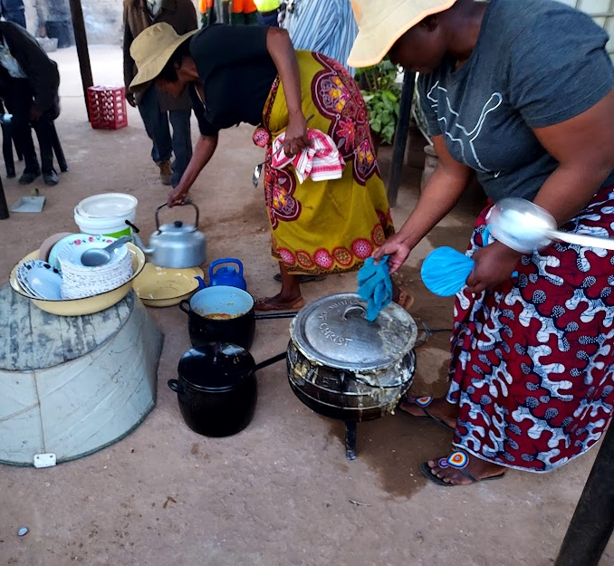
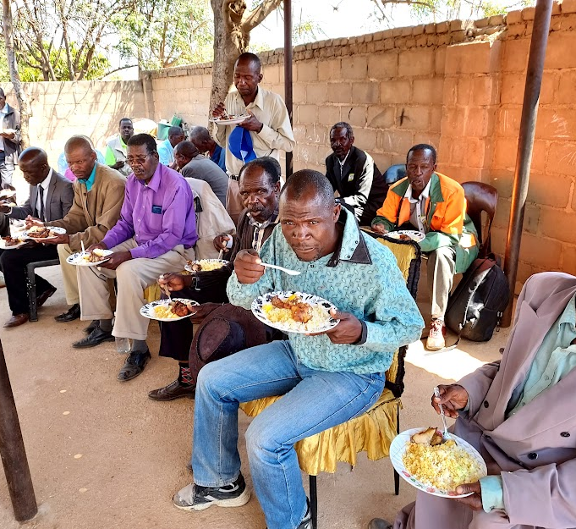
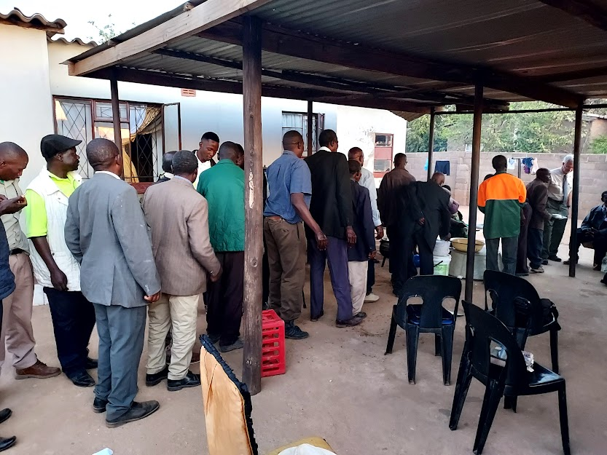
Feeding the preachers at Bigboy’s
The sisters fixed the sadza.
The preachers lined up for the sadza.
The preachers ate the sadza!

Slide 11
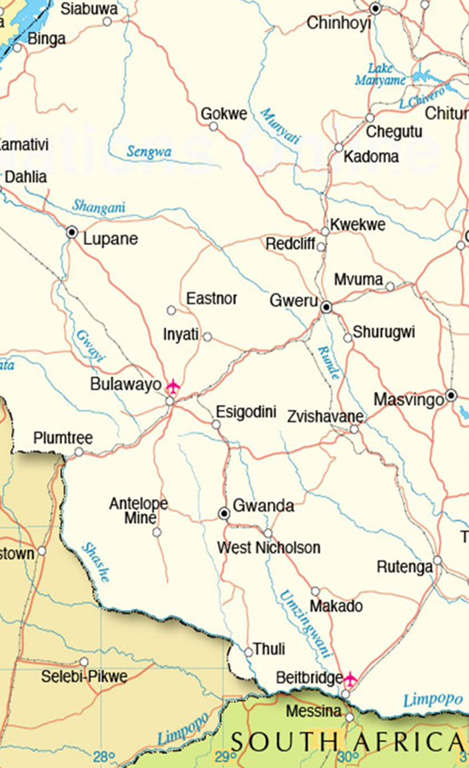
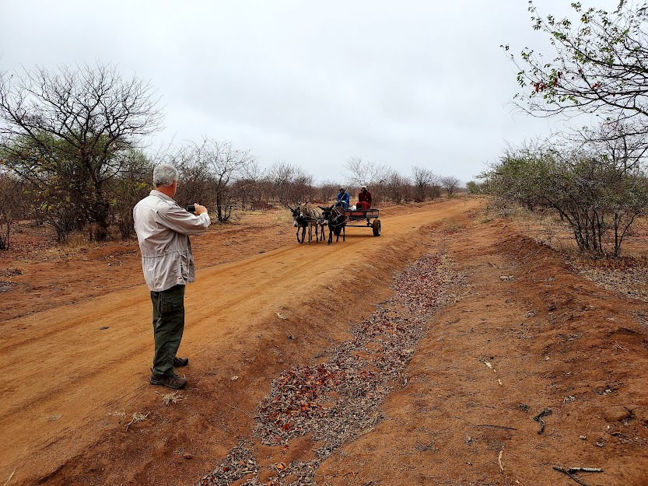


Visiting Churches in Gwanda South September 7
Ngoma
Nhwali
Guyu
Notes:
The day was cool and rainy and the roads were desolate. The only traffic we saw on the dust/dirt roads were donkey carts.

Slide 12
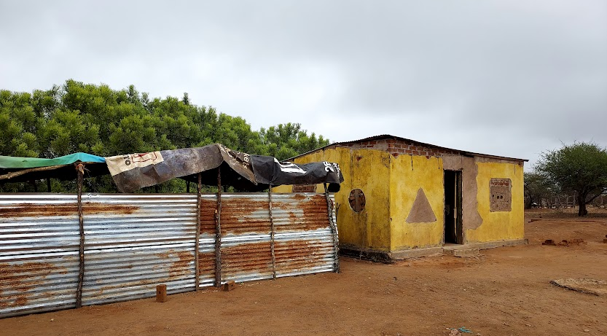
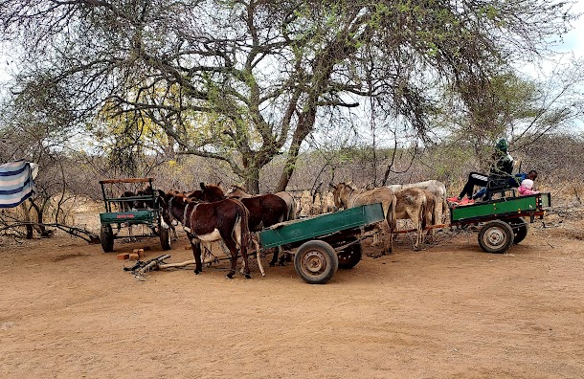
Meeting place at Ngoma The taxis were triple parked.
Notes:
2 and ½ hour drive, deep in the bush

Slide 13
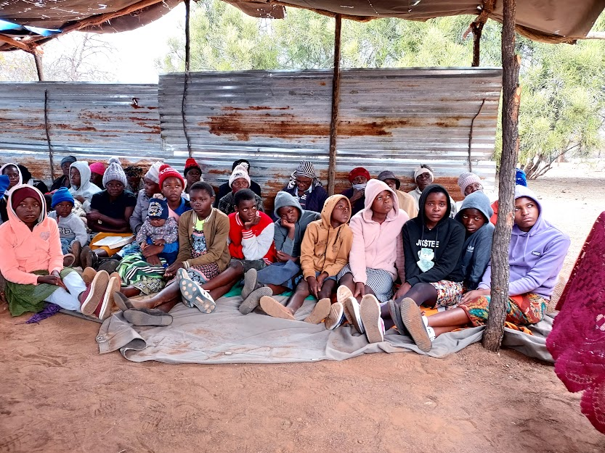
Young people listening to the gospel at Ngoma

Slide 14
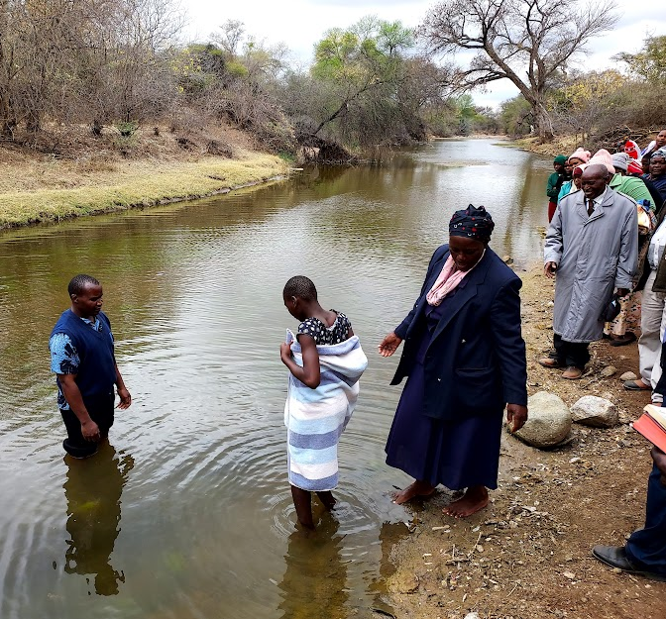
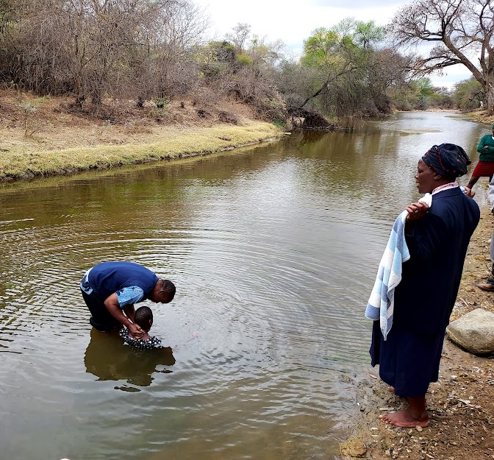
One of six young people who obeyed the gospel at Ngoma.

Slide 15
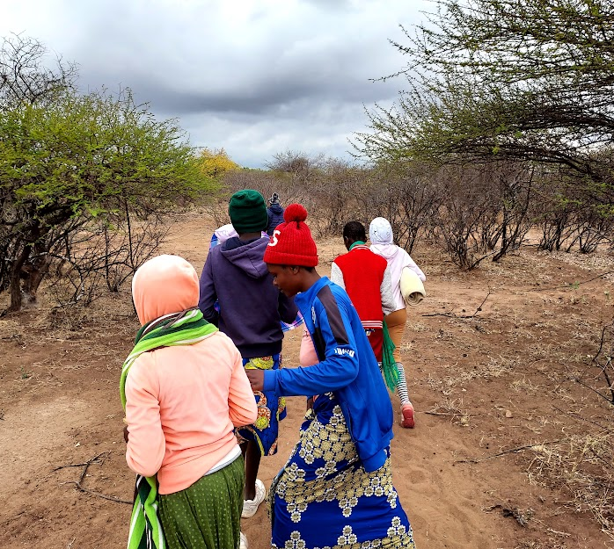
Six newborn Christians, walking a difficult path.

Slide 16
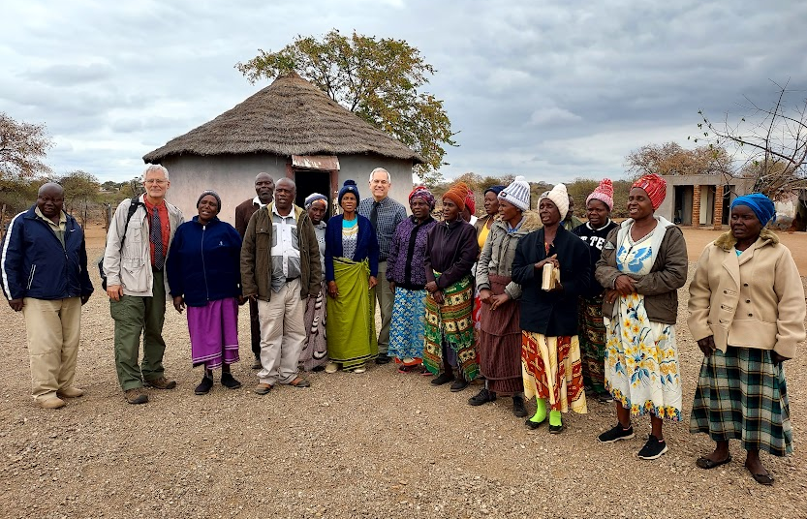
The saints at Nhwali loved to sing but needed more hymn books and Bibles.
Notes:
$500 from individuals was left with Bigboy to purchase and deliver the Bibles and song books – they have been purchased already

Slide 17
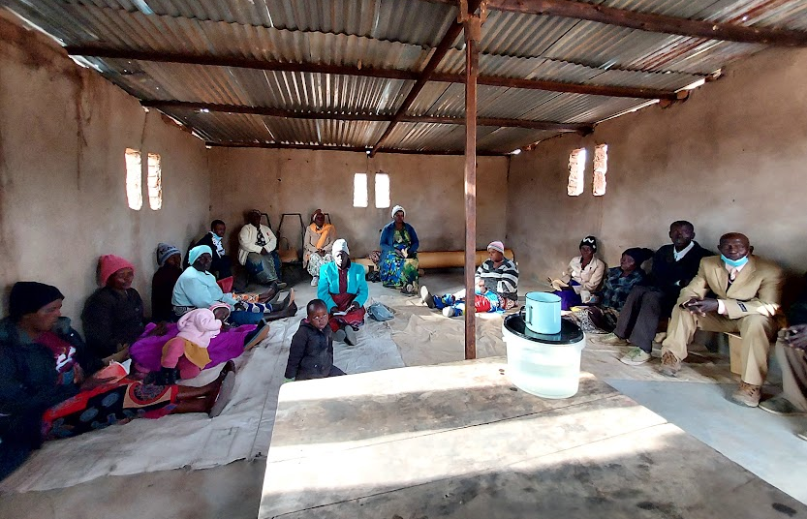
The saints at Guyu requested chairs.
Notes:
The chairs were purchased from individual funds and delivered.

Slide 18
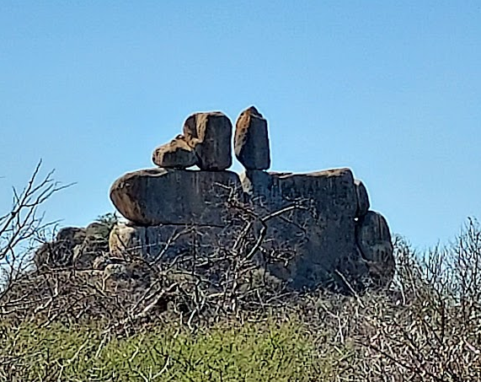
Visiting in Gwanda North September 8
Motsholomotshe
Notes:
The washboard roads and the rock formations alongside were incredible.

Slide 19
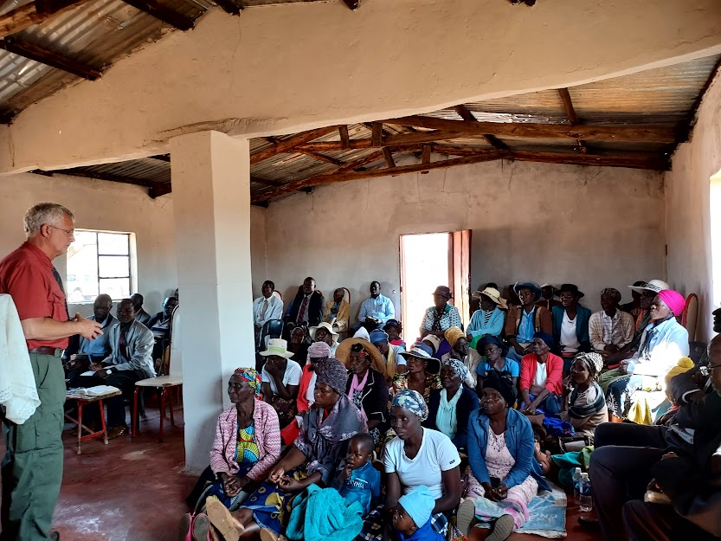
Preaching at Matsholomotshe

Slide 20
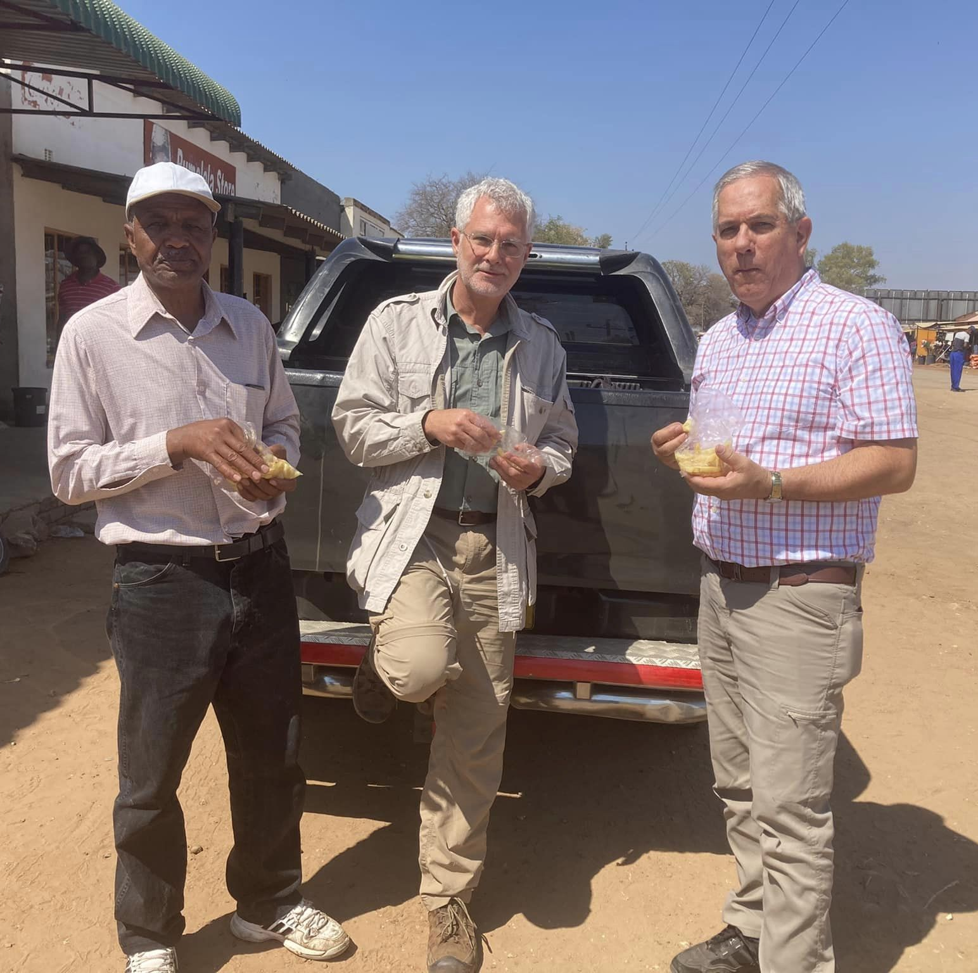
Visiting churches in Lupane & Tsholotsho September 9-10
Notes:
There are a total of 28 churches in these two areas. Most of them planted by Solomon Chikomba and Mountbatten Brewer. The first day included 8 hours of driving, with 6 of those hours on dust/dirt roads.

Slide 21
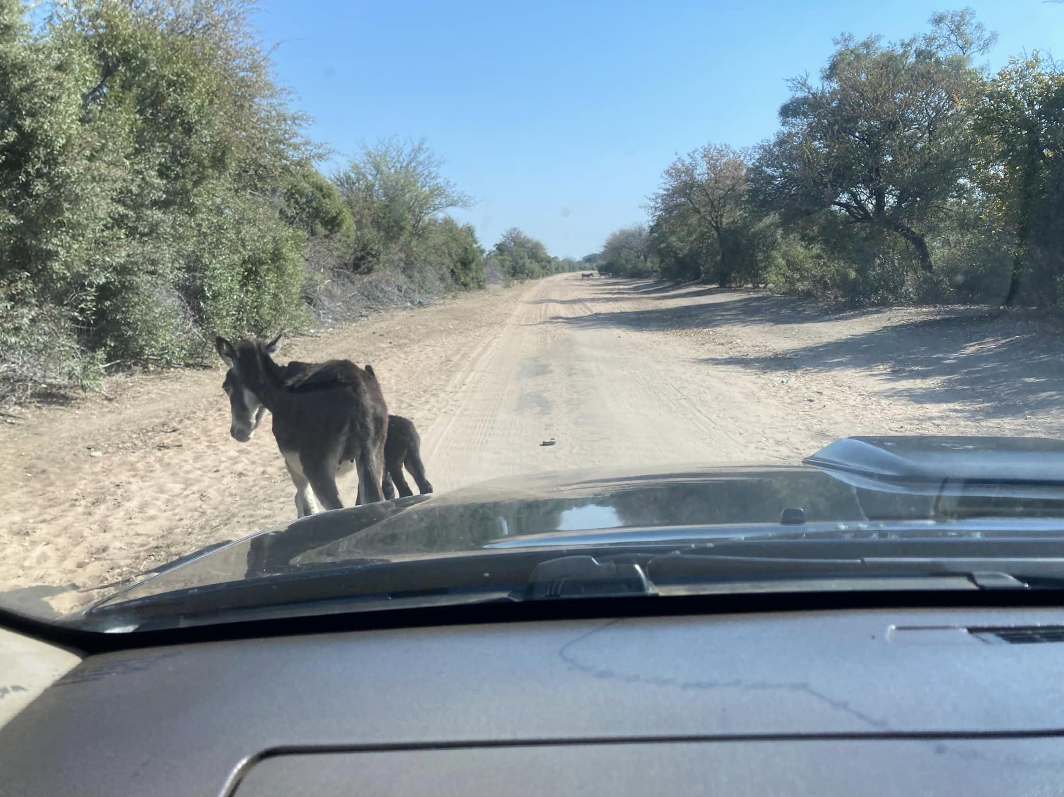
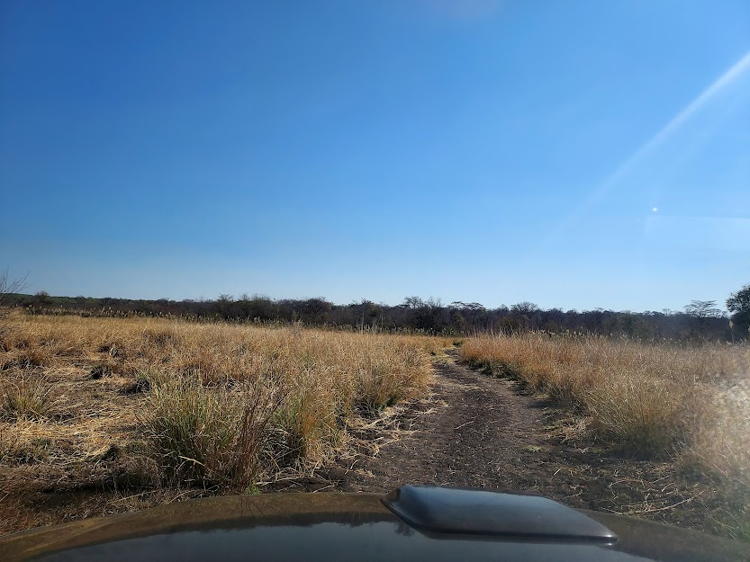
We rode many miles on “dust roads”

Slide 22
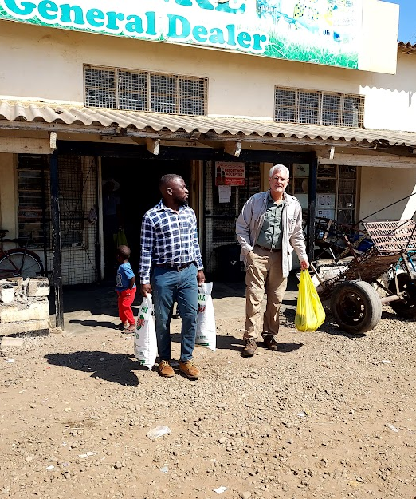
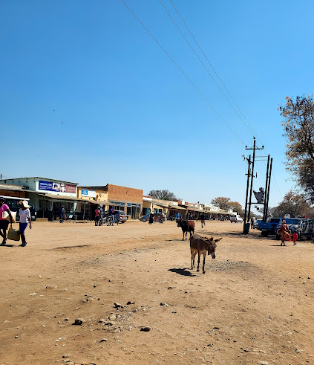
Tsholotsho Town Joe and Solomon Chikomba visited the General Store

Slide 23
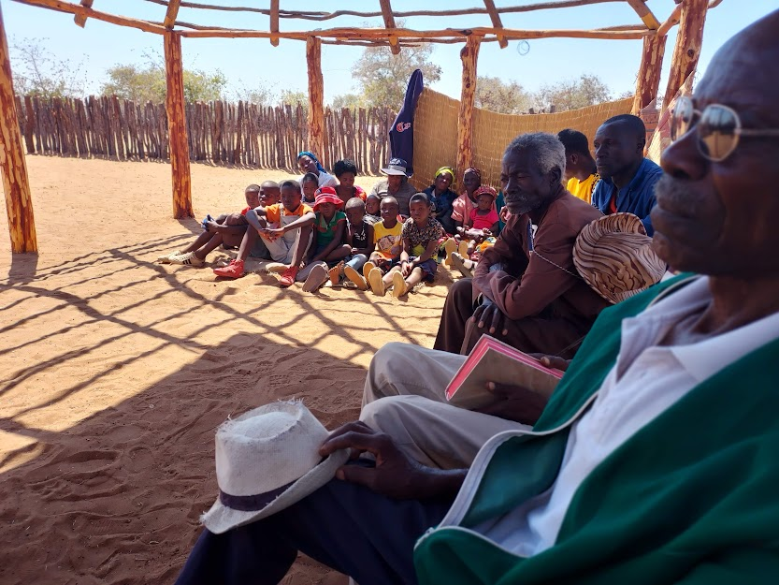
The Church at Luhanjani needed thatch of the roof of their shelter

Slide 24
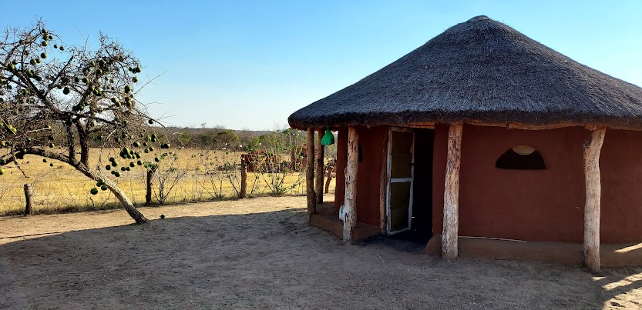
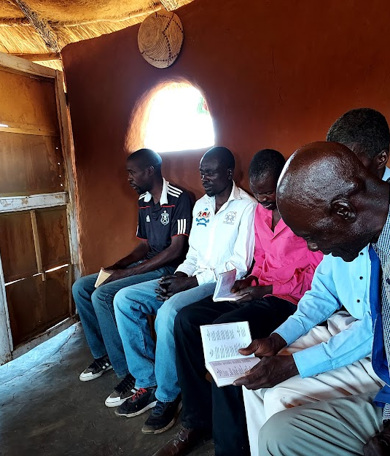
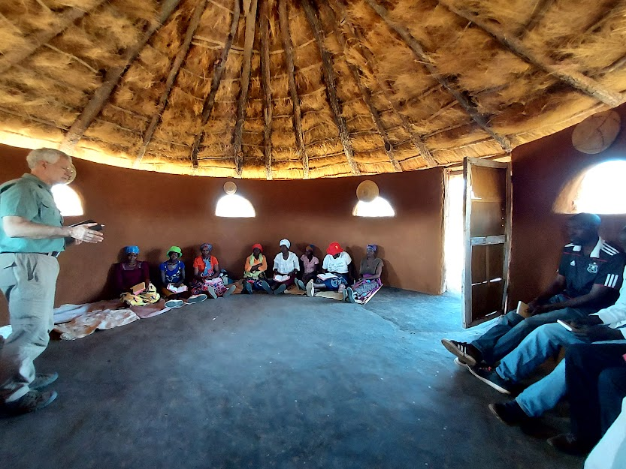
The small church at Mandawe is new and meets in this round hut on a farm.

Slide 25
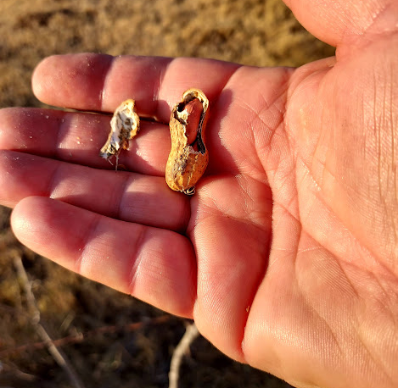
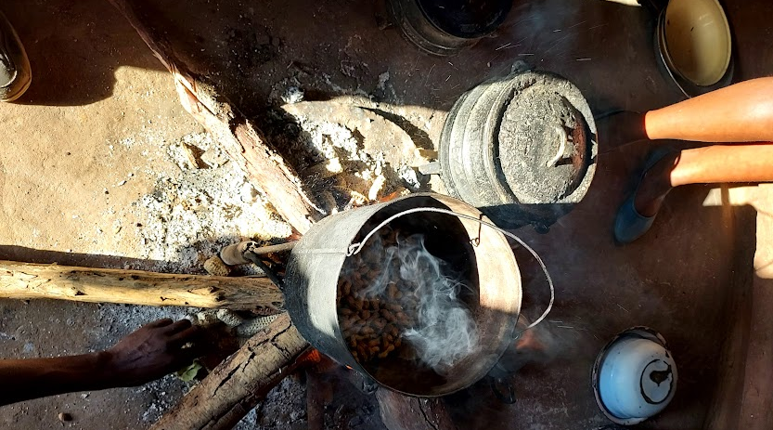
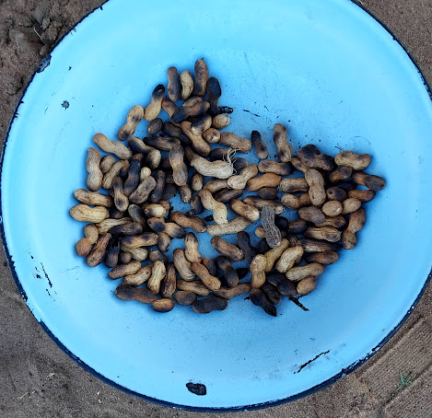
They gave us fresh roasted peanuts.

Slide 26
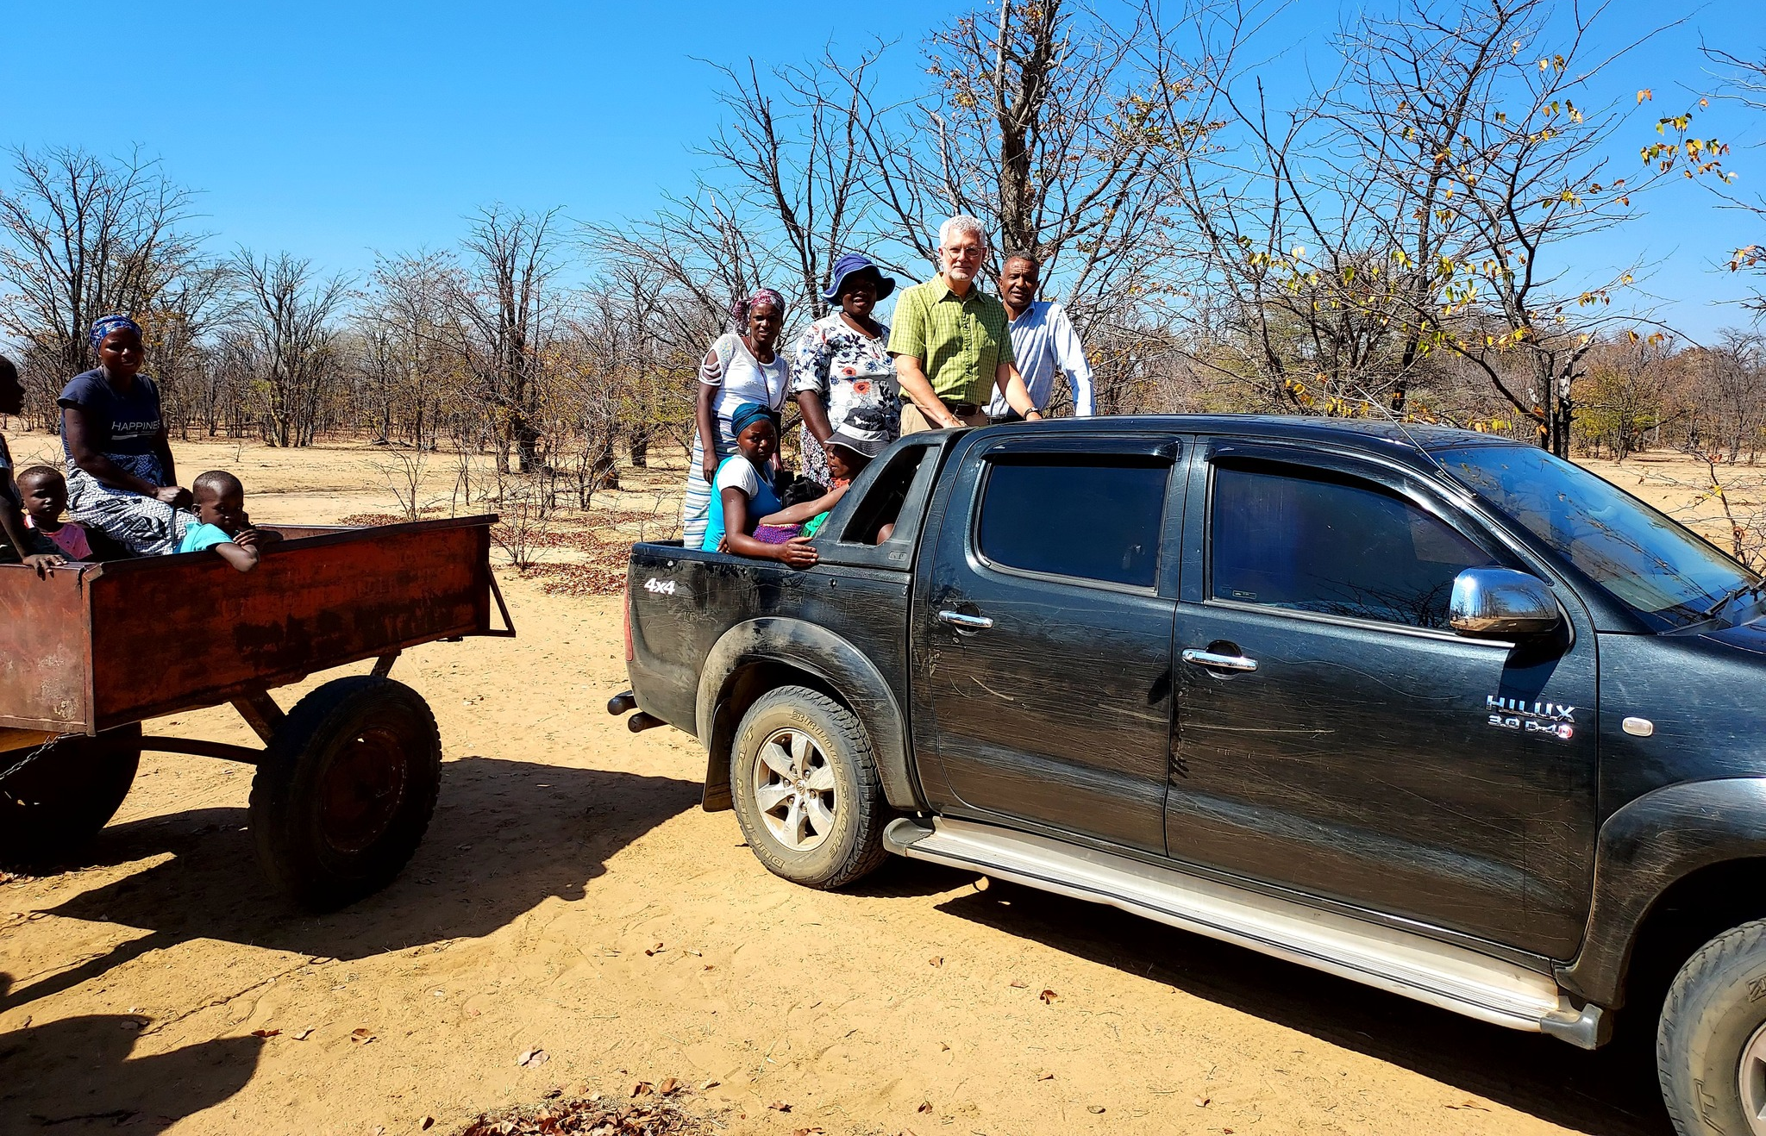
Picking up the overflow from the donkey taxi
Notes:
. These folks were traveling to meet with us. One sister was wheelchair bound.

Slide 27
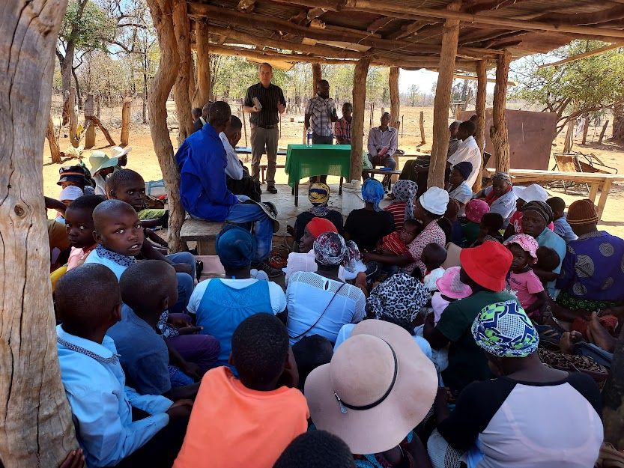
There was a great crowd at Luphanda

Slide 28
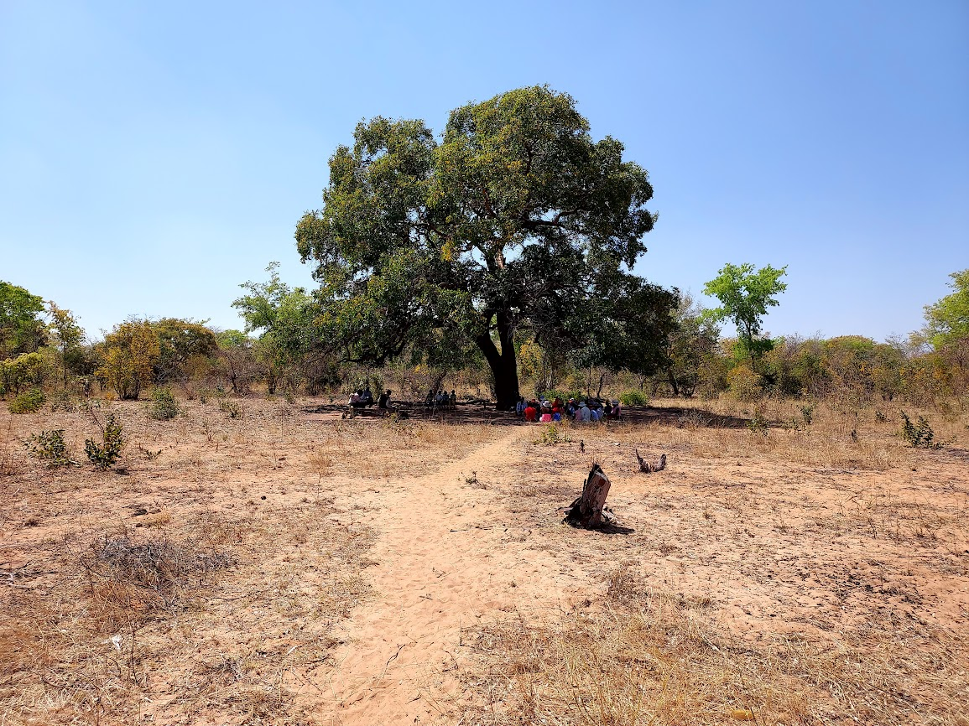
Approaching the gathering place of the Madojwa Church

Slide 29
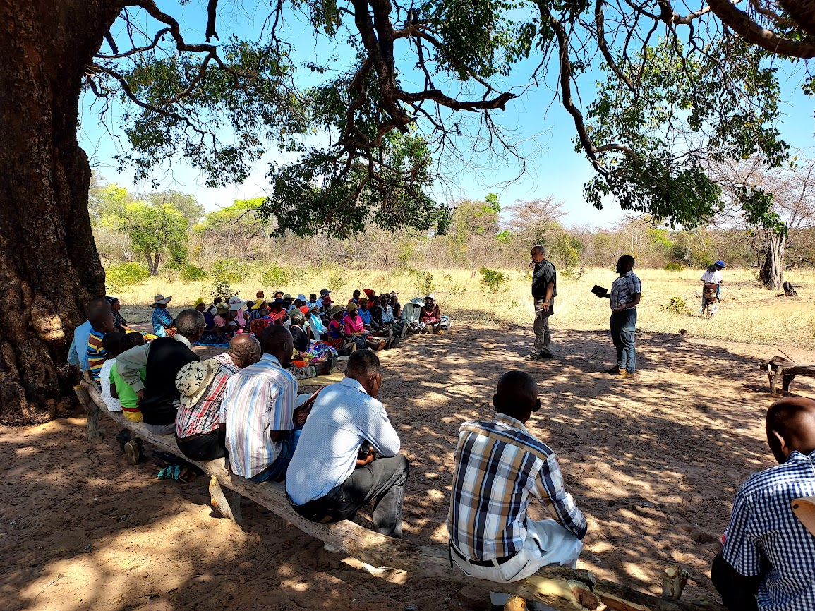
Preaching at Madojwa with Solomon translating

Slide 30
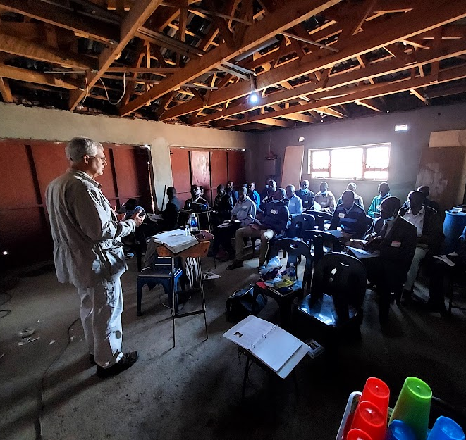
Classes for Preachers at Professor Moshoko’s in Bulawayo
September 13-14.
28 attended.
Joe taught Nehemiah: Lessons in Leadership, and I taught Epistles to Preachers: 1 & 2nd Timothy and Titus.

Slide 31
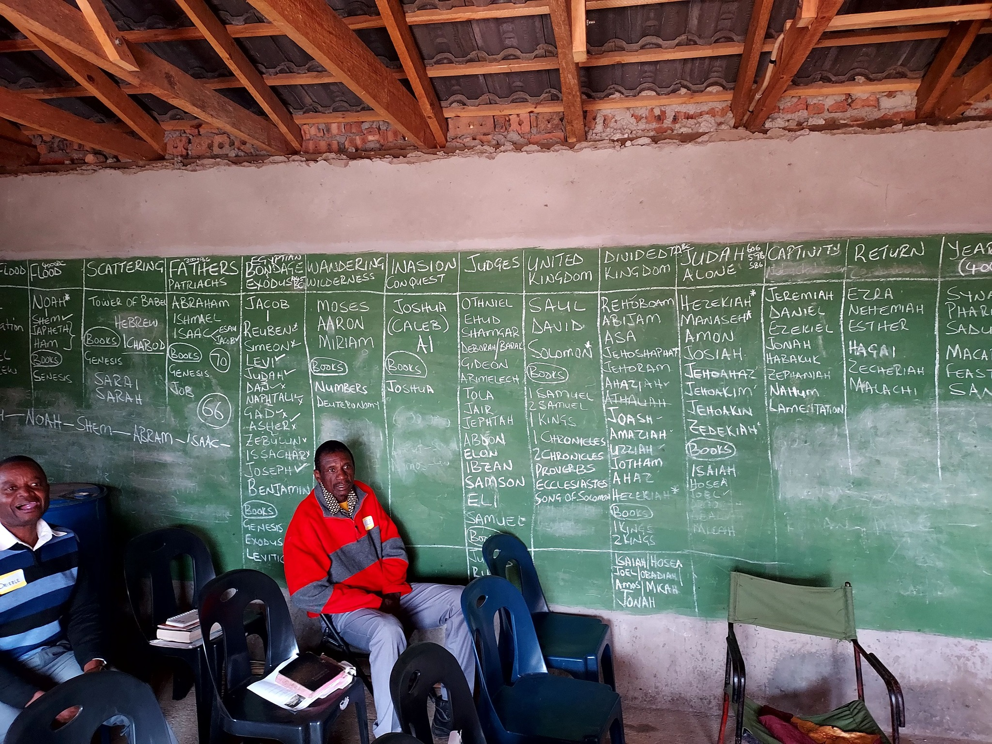
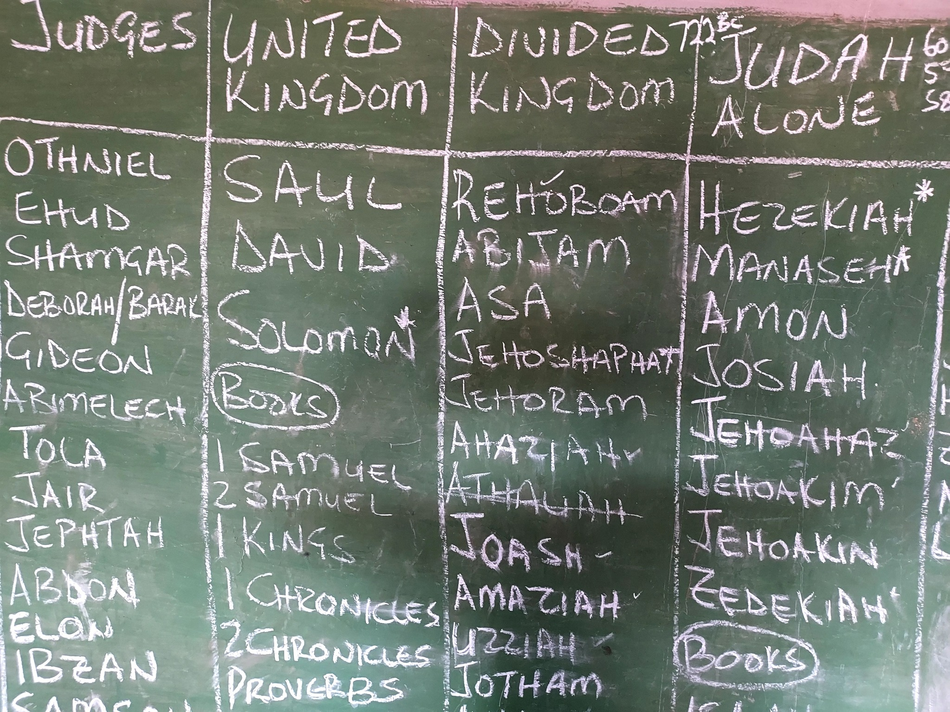
Professor uses this room to teach the 17 Bible periods.

Slide 32
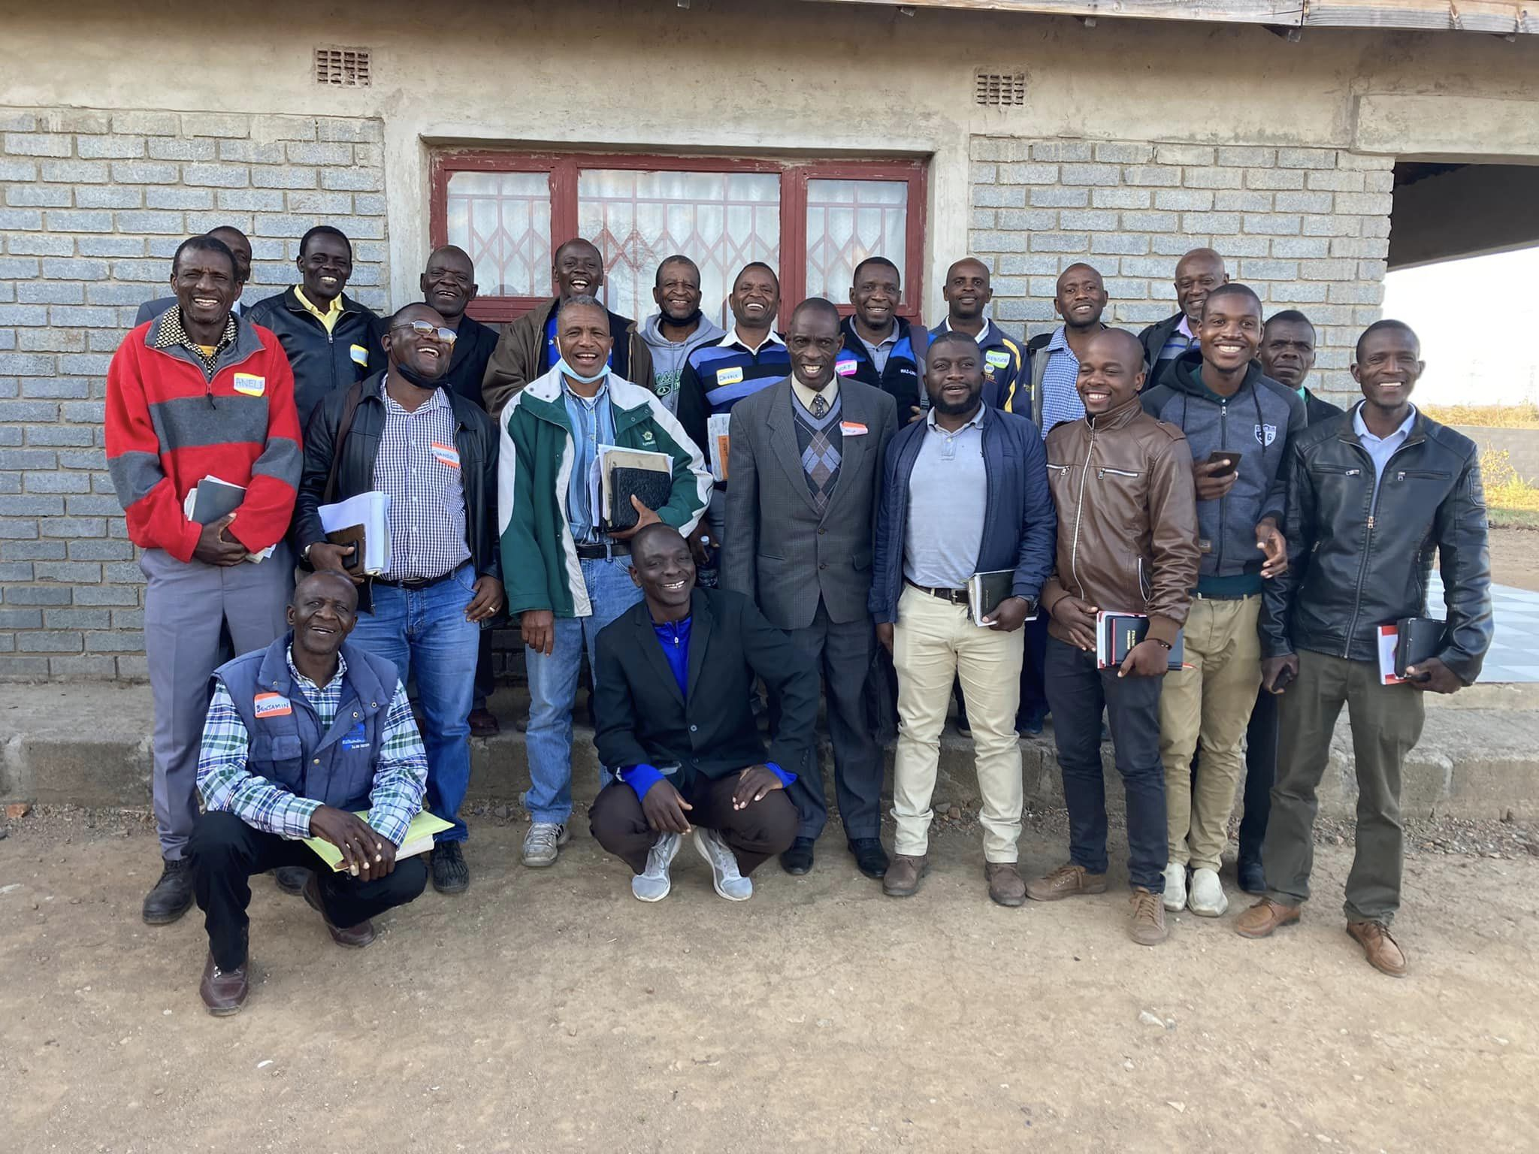
Some of the men who studied with us at Professor’s.

Slide 33
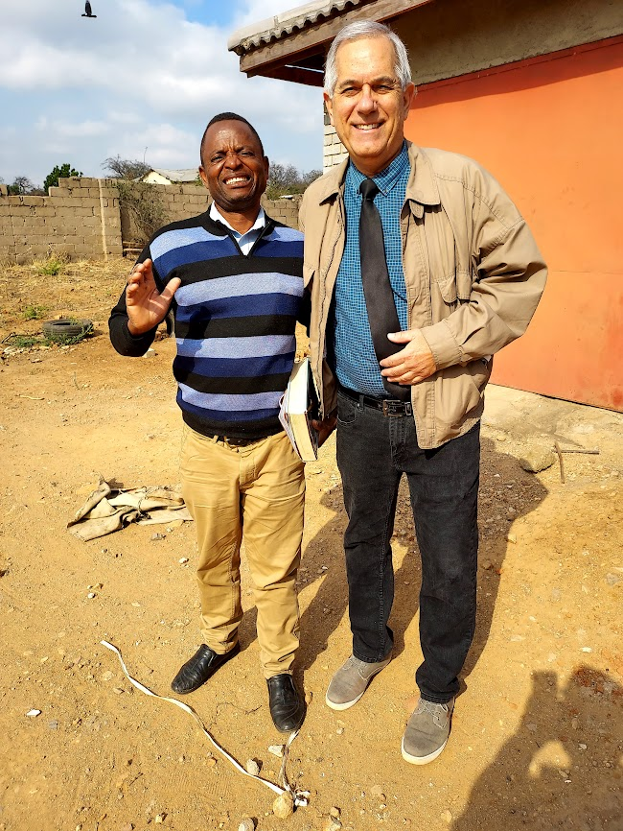
Kurauone Mubvumbi preaches in the remote Gokwe area of Zimbabwe.

Slide 34
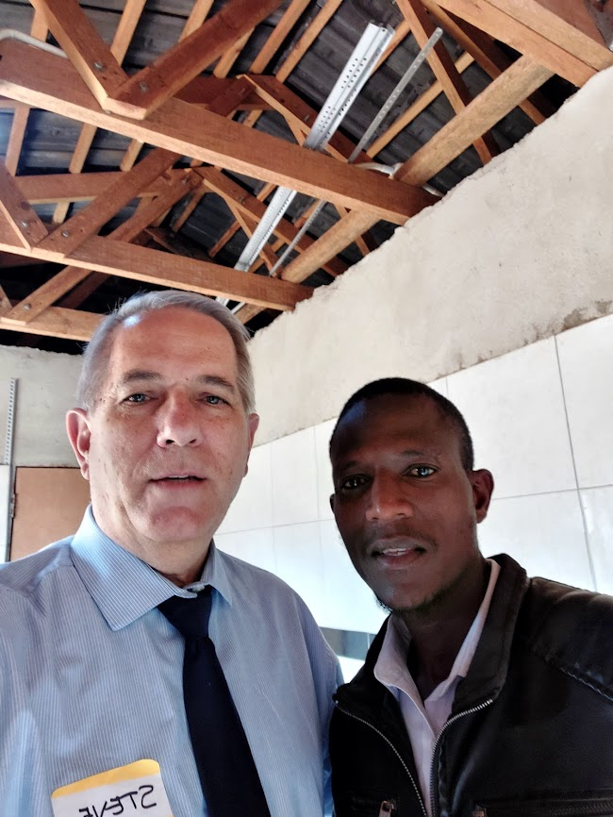
Austin Mpala preaches in the boarder town of Plumtree. There are 42 women and 3 men in the congregation.

Slide 35
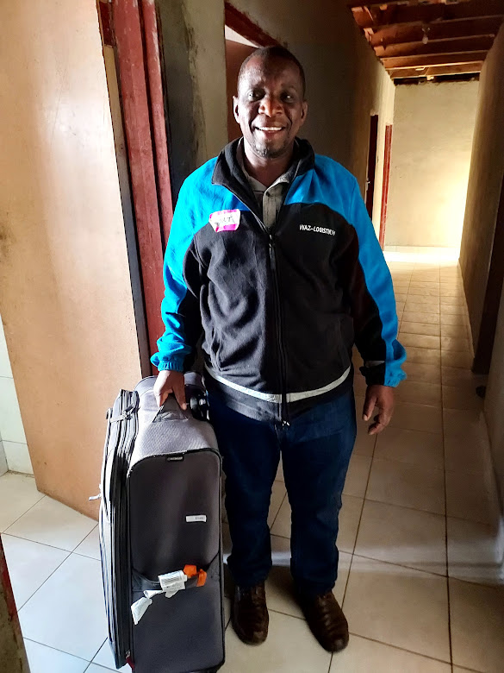
Short Mumpande preaches in Binga and Hwange in the northeast of Zimbabwe. We carried some items to him from those who support him that will be helpful in his work.

Slide 36
The Gospel is for All
Of one the Lord has made the race,
Thro’ one has come the fall;
Where sin has gone must go His grace; The Gospel is for all.
Say not the heathen are at home,
Beyond we have no call,
For why should we be blest alone?
The Gospel is for all.
Received ye freely, freely give,
From every land they call;
Unless they hear, they cannot live:
The Gospel is for all.
The blessed Gospel is for all,
The Gospel is for all;
Where sin has gone must go His grace:
The Gospel is for all.
~ J.M. McCaleb
Notes:
The gospel is for you!
Jesus has “redeemed us to God by Your blood Out of every tribe and tongue and people and nation.” – Revelation 5:9

